Slide 1

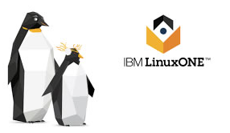
HYPERLEDGER FABRIC FOR THE ENTERPRISE Privacy and Security Strategies
Workshop
Grant Steinfeld¹
¹ Developer Advocate – Blockchain and Java, IBM @gsteinfeld
https://bit.ly/2xf0PvK

Slide 2
Hyperledger Fabric permissioned private blockchains Trust Security and Privacy

Slide 3
Security
51% attack?
SecOps
Platform
SRE / Security
Pen testing TLS
Notes:
Hyperledger Fabric undergoes periodic Security and License Audits whose results are publicly
A security assessment for v1.1 was published by Nettitude in September of 2017, and , and the assessment for v2.0.x is in progress.
IBM Cloud requires that all services undergo pen testing and that all endpoints use TLS. Specifically,
TLS 1.2 is enabled for all endpoints. All communication between nodes (peer to peer, peer to orderer) is secured with TLS and all communication from the UI to the nodes is also TLS
IBM Blockchain Platform will have support for HSM in 3Q.

Slide 4


THREAT ? ➔ VECTORS
Peer pull requests / Auditor Role
Continuous Integration – DevOps Infra
EXTERNAL
INTERNAL
Notes:
Consurtium
Nature of blockchain
Privacy
External
Hackers – indication of environment/cloud/datacenter setup wrt security
Industrial Espionage, bored summer vacation

Slide 5
SmartContract - chain code

Slide 6
Flexibility choices to run Hyperledger Fabric
VMWare OpenStack
Cloud / Hybrid cloud
HARDWARE
Intel – Linux
IBM Power - Linux
IBM Z
IBM LinuxONE
IBM Cloud Private (ICP)
On premises
Security Improvement
Notes:
Because of its distributed architecture, blockchain is best suited for the hybrid cloud model and can be deployed both in the public cloud and on premises.
The decision on where to deploy block- chain could, for example, depend on if a managed service is preferred for ease of use, or whether government, industry, or corporate regulations mean that data needs to be held locally.

Slide 7
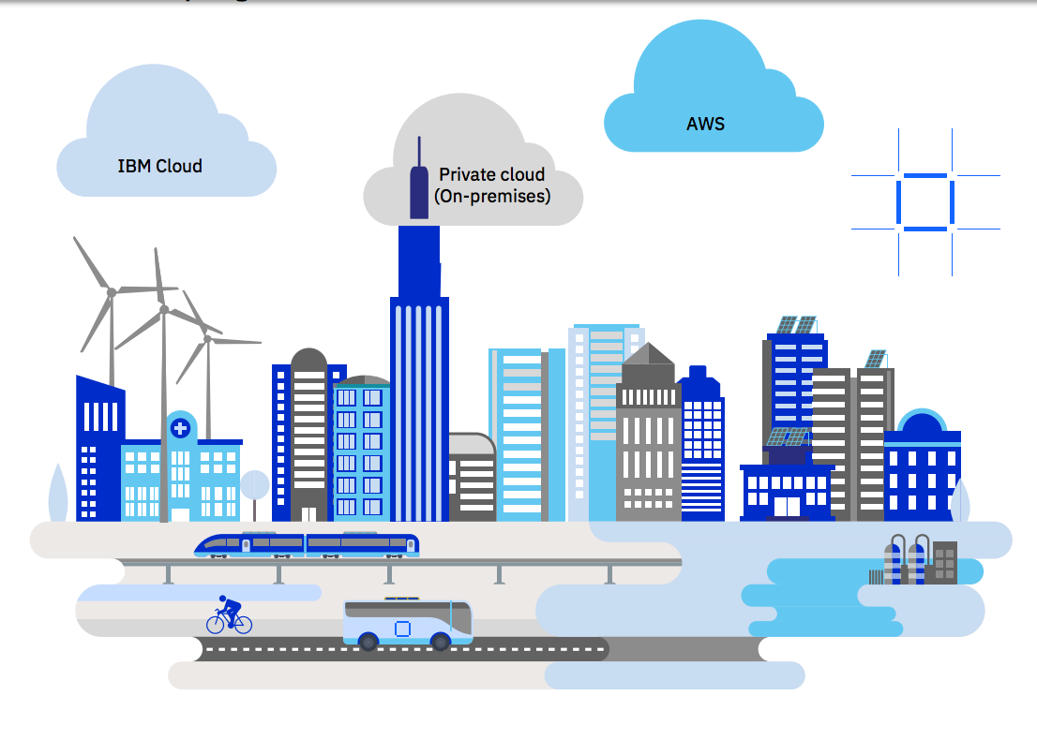
Deploy Hyperledger Fabric ot IBM Blockchain – ANYWHERE!
Notes:
Because of its distributed architecture, blockchain is best suited for the hybrid cloud model and can be deployed both in the public cloud and on premises.
The decision on where to deploy block- chain could, for example, depend on if a managed service is preferred for ease of use, or whether government, industry, or corporate regulations mean that data needs to be held locally.
next
You have Developed your first Hyperledger Fabric application How to get it into the cloud
Many options now
Just announce IBP anywhere!
A full-stack cloud platform that spans public, private and hybrid environments.
IBM cloud – reliabily – scalability – speed – IBM Garage / Consulting …
Build with a robust suite of advanced data and AI tools, and draw on deep industry expertise to help you on your journey to the cloud.
--------------------------
Hybrid Cloud on IBM Z

Slide 8
LinuxONE Security Enables Blockchain
Built-in encryption
Key management
Workload isolation
IBM Secure Service Container
Notes:
The IBM LinuxONE platform is designed to make applications
Perform faster and more efficiently
with the highest levels of security
Customized Go language

Slide 9

VM
Red Hat
SuSE
encryption
END TO END
Built in Encryption
LinuxONE hardware encryption:
Dedicated I/O processors
Crypto processors built right into microprocessor cores
Additional dedicated crypto processors via add-on accelerators
IBM Cloud Hyper Protect Crypto Services
IBM Key Protect
IBM Cloud data
IBM Secure Containers
Notes:
Encryption and decryption can decrease performance, and Linux- ONE has dedicated on-chip co-processors for hardware encryption and decryption of data without the typical processing overhead associated with software encryption. The low overhead of LinuxONE hardware encryption enables pervasive encryption to be practical, automatically protecting all data.
is a cryptography service designed to provide LinuxONE based security capabilities to the cloud with a complete set of encryption and key management services
Cloud advantage :::
IBM Cloud Hyper Protect Crypto Services:
The system provides high density and unique transaction in flight and
at rest protection accessible in the cloud
Integrates with key services: IBM Key Protect and IBM
This service has the industry's highest FIPS 140-2 Level 4 crypto
certification.
IKS encrypts the storage and customers can use their own key secured by IBM Key Protect. Note that the user must configure the IKS cluster they provide to IBM Blockchain Platform with the appropriate protection
The IBM Blockchain Platform console is provisioned in an IKS cluster managed by IBM. This IKS cluster is configured with the IBM Key Protect option.

Slide 10
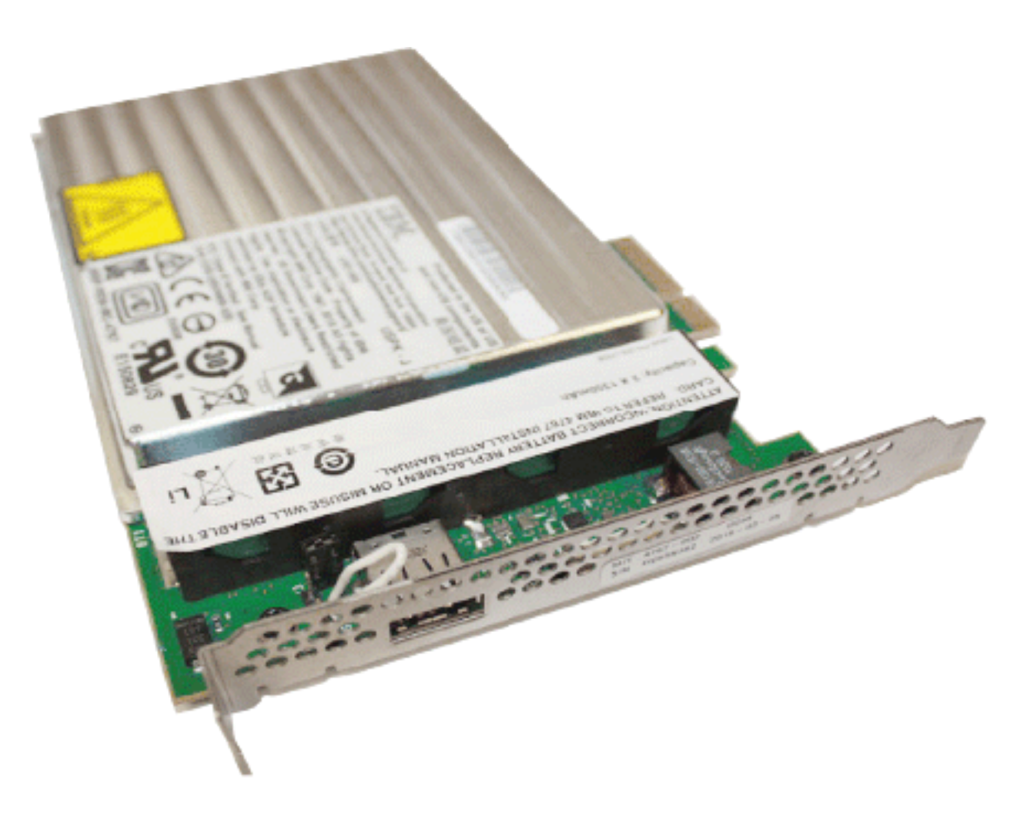
Air Gap Separation
EAL5+ Certification
Workload Isolation
Firmware ensures separation of running systems/VM’s on the same physical machine.
Hardware Security Module (HSMs)
Notes:
firmware virtualization of logical partitions (LPARs)
EAL5+, one of the highest commer-cially available certifications.

Slide 11
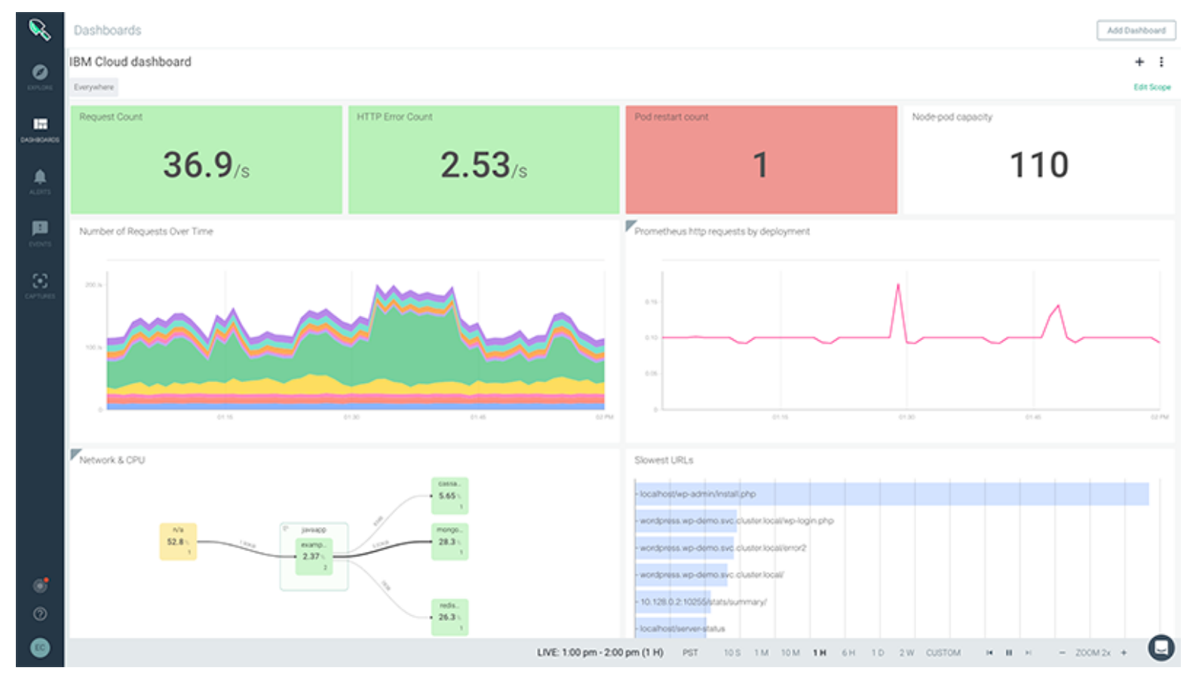
Isolated tenants – Calico
Kubernetes Cluster + Isolation befits of Mainframe hardware
IBM Secure Service Container
Takes workload isolation to next level!
IBM Cloud IKS + Sysdig alerts
Notes:
Building on logical partitions is the IBM Secure Service Container technology, which takes workload isolation to the next level by providing a secure computing environment for container-based applications.
Isolated tenant net􏰎 works leverage Calico (a network policy service for Kubernetes clusters) to improve performance and network isolation inside clusters.
Sysdig Get operational visibility into Kubernetes-based applications, services and platforms
To make these hardware solutions available to the blockchain software, the Go language used to implement the blockchain Hyperledger Fabric has been ported and optimized for use on LinuxONE hardware.

Slide 12
Go language is ported and optimized for LinuxONE to make these hardware solutions available for Hyperledger Fabric
Notes:
HLF WRITTEN in GO

Slide 13
Privacy
Channels
MSP/ Identity
Private Data
Compliance / Legal
Notes:
MSP Membership Provider
Membership Service Provider (MSP) comes into play — it identifies which Root CAs and Intermediate CAs are trusted to define the members of a trust domain, e.g., an organization, either by listing the identities of their members, or by identifying which CAs are authorized to issue valid identities for their members, or — as will usually be the case — through a combination of both.
The power of an MSP goes beyond simply listing who is a network participant or member of a channel. An MSP can identify specific roles an actor might play either within the scope of the organization the MSP represents (e.g., admins, or as members of a sub-organization group), and sets the basis for defining access privileges in the context of a network and channel (e.g., channel admins, readers, writers).

Slide 14
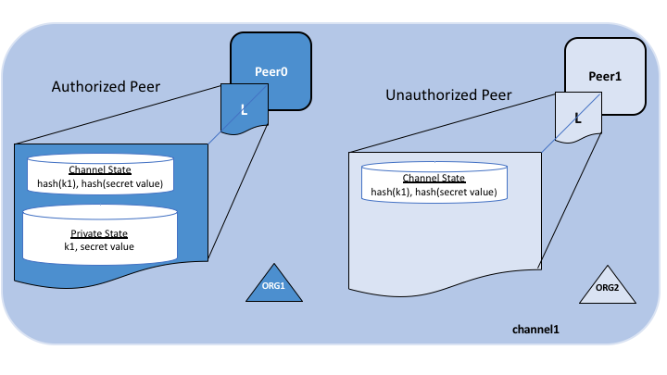
Private Data Collections
Offchain -> SideDB
A hash of that data, which is endorsed, ordered, and written to the ledgers of every peer on the channel.
Notes:
In cases where a group of organizations on a channel need to keep data private from other organizations on that channel, they have the option to create a new channel comprising just the organizations who need access to the data.
However, creating separate channels in each of these cases creates additional administrative overhead (maintaining chaincode versions, policies, MSPs, etc), and doesn’t allow for use cases in which you want all channel participants to see a transaction while keeping a portion of the data private.
The actual private data, sent peer-to-peer via gossip protocol to only the organization(s) authorized to see it. private state database on the peers of authorized organizations (sometimes called a “side” database, or “SideDB”),
The ordering service is not involved here and does not see the private data.
The hash serves as evidence of the transaction and is used for state validation and can be used for audit purposes.
Collection members may decide to share the private data with other parties if they get into a dispute or if they want to transfer the asset to a third party. The third party can then compute the hash of the private data and see if it matches the state on the channel ledger, proving that the state existed between the collection members at a certain point in time.

Slide 15
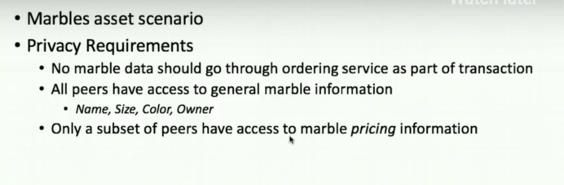
Private data – Marbles asset scenario
Notes:
Off video

Slide 16
Private data – Marbles asset scenario
Notes:
Off video

Slide 17
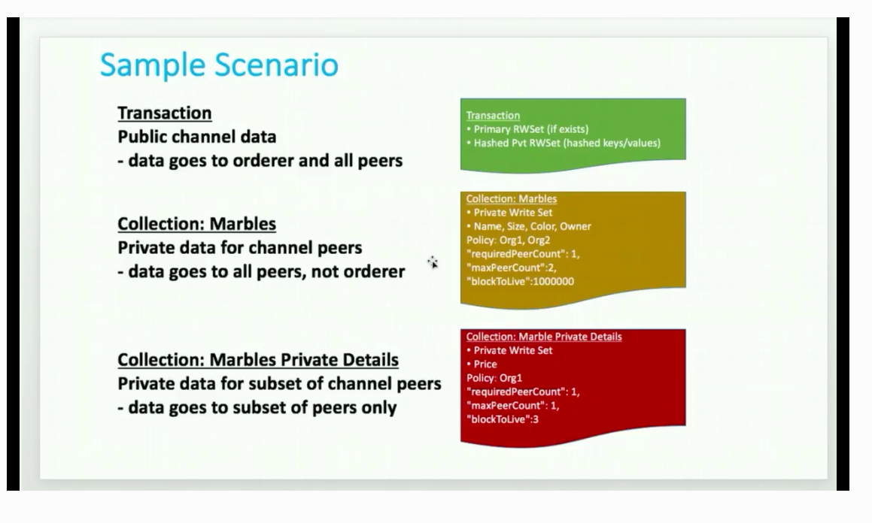
Private data: Marbles asset scenario
Notes:
If one peer offline it’s OK
Only Org 1 has access
Also
Block to live – even private data can expire ( super sensitive )
blockToLive: 3 – 3 blocks then purged ( 0 forever )

Slide 18
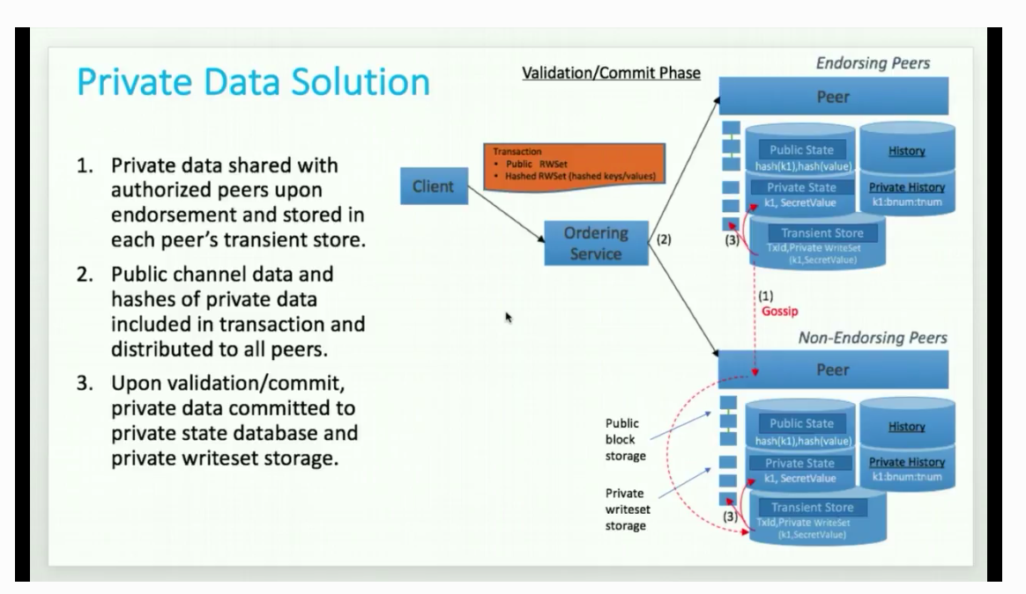
3 steps
Notes:
Off video

Slide 19
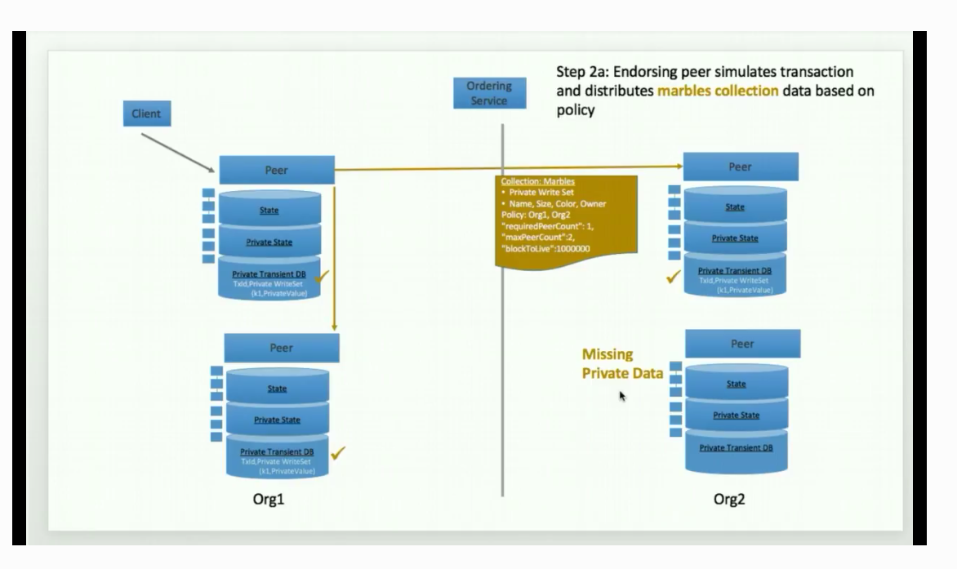
Flow – Step 2a
Notes:
If one peer offline it’s OK
Only Org 1 has access
Also
Block to live – even private data can expire ( super sensitive )
blockToLive: 3 – 3 blocks then purged ( 0 forever )

Slide 20
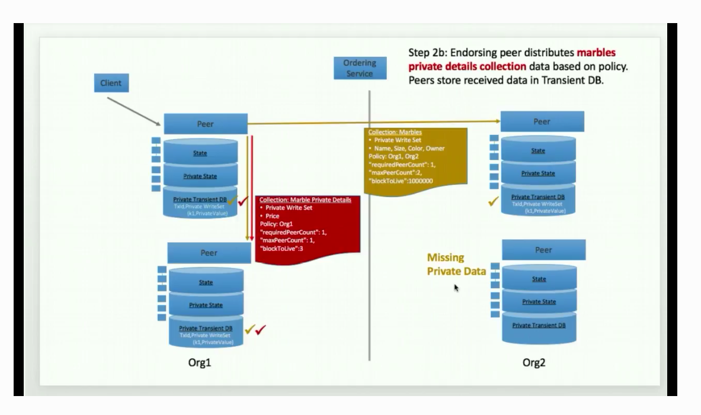
Flow 2b
Notes:
Second collection with marble pricing info
Sent to 1 peer

Slide 21
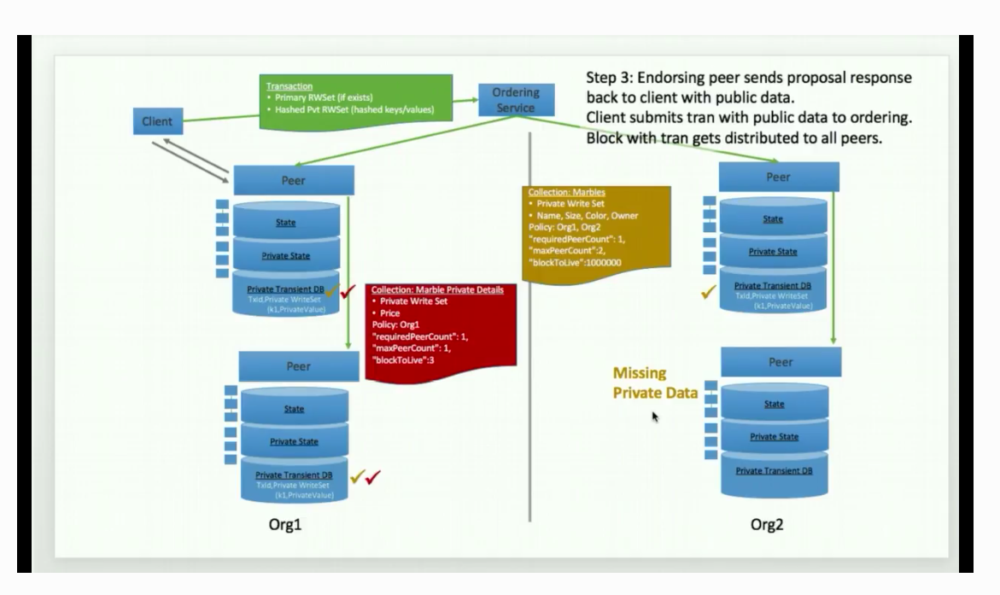
Private data – based of the infamous Marbles asset scenario
Notes:
Step 3
Endorsing peer sends proposal ….

Slide 22
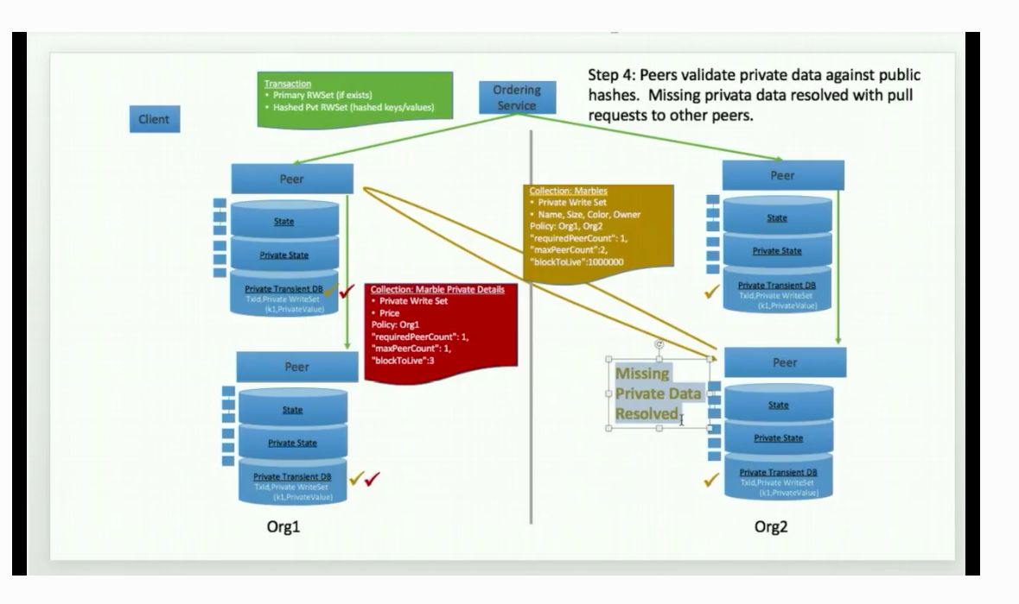
Private data – based of the infamous Marbles asset scenario
Notes:
Step
Missing private data

Slide 23
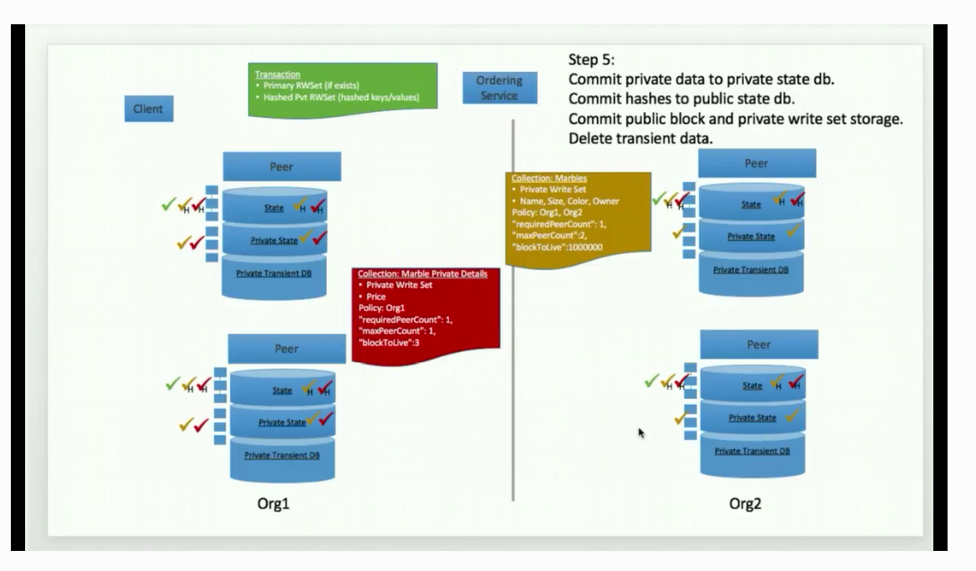
Private data – based of the infamous Marbles asset scenario
Notes:
Step 5

Slide 24

CODE
Notes:
Private Data HLF Tutorial Marble Data https://hyperledger-fabric.readthedocs.io/en/release-1.4/private_data_tutorial.html

Slide 25
Hyperledger Fabric (HLF) ==> LEARNING PATHS / REFERENCES
Hyperledger Fabric Tutorials Private Data Tutorial Marble Data https://hyperledger-fabric.readthedocs.io/en/release-1.4/private_data_tutorial.html IBM Code Patterns [ https://developer.ibm.com ]
Build your first private blockchain network on InterPlanetary File System
Comprehensive storage solution addresses data loss, duplication, tampering problems, and more
https://developer.ibm.com/patterns/build-first-private-blockchain-network-interplanetary-file-system/
Medical Data using IBM Cloud IBPv2 https://developer.ibm.com/patterns/storing-private-data-off-chain-using-blockchain-think-healthcare-use-case
IBM LinuxONE for dummies
https://www.ibm.com/downloads/cas/LBOVYYJJ
HLF security audit process https://www.hyperledger.org/blog/2018/02/07/hyperledger-fabric-1-0-release-process
Blockchains and SmartContract security - Chris Wysopal, CTO Veracode
https://searchsecurity.techtarget.com/news/252460033/Chris-Wysopal-talks-blockchain-hype-and-realistic-uses

Slide 26

Thank you!
Faces of IBM
https://w3.ibm.com/w3publisher/faces-of-ibm/faces-of-pride
Join Call for Code
https://callforcode.org/
https://bit.ly/2xf0PvK
Future events:
Master Reactive Systems on IBM Cloud using Lagom Microservices [Hands-on]
https://www.meetup.com/ibmcodenyc/events/262583689/
IBM Cloud
<><VCPI URL>
OR
https://cloud.ibm.com
Notes:
The winner of the first Call for Code Global Award received $200,000, open source project support from The Linux Foundation

